Slide 1

STREET LIGHT SYSTEM
Team Members Detail:
1. Divya Dev Choudhary, 20scse1180140,AIML-2
2. Kunal, 20scse1010015, Section 1

Slide 2
Prior Art and Background
The main objective of the project is to develop a smart street light system which reduces the consumption of electricity by using effective ways. Smart street lights are effective and extremely dependable. The two sensors, LDR (light dependent resistor) and a IR sensor, the role of these sensors in the project is to detects the intensity of atmospheric light and accordingly the street lights will switched on and also when detects an object coming towards the street light and it sends the message to the serially connected street lights through the cloud so that every street light in the particular serial will be automatically switched on. Traffic control. Video monitoring can help cities better understand traffic and pedestrian patterns, make adjustments, as well as route emergency-response vehicles around congested areas. Parking control. Street light sensors can provide information about available parking in densely populated areas, as well as monitor vehicles for parking violations without sending personnel out on the street. Crime detection and prevention. Street lights with video cameras can aid police in solving crimes after they happen. Reduced energy cost. Smart lighting that optimises dimming, on/off programming, or motion activation can increase cost savings over simple LED luminaries. Optimized maintenance. With smart street lighting, cities can predict lamp failures using data collected, such as the number of hours the light has operated and the status of a light fixture.

Slide 3
Prior Art and Background
Scientific basis of proposed work a)ESP8266 NodeMCU ESP8266 NodeMCU is an open source IoT platform. It includes firmware which runs on the low cost Wi-Fi enabled ESP8266 Wi-Fi SoC from Espressif Systems, and hardware which is based on the ESP-12 module. It has GPIO, SPI, I2C, ADC, PWM AND UART pins for communication and controlling other peripherals attached to it. On board NodeMCU has CP2102 IC which provides USB to TTL functionality. b) Infrared sensor An infrared sensor is an electronic device that emits in order to sense some aspects of the surroundings. An IR sensor can measure the heat of an object as well as detects the motion.These types of sensors measures only infrared radiation, rather than emitting it that is called as a passive IR sensor. Usually in the infrared spectrum, all the objects radiate some form of thermal radiations. These types of radiations are invisible to our eyes that can be detected by an infrared sensor.The emitter is simply an IR LED and the detector is simply an IR photodiode which is sensitive to IR light of the same wavelength as that emitted by the IR LED. When IR light falls on the photodiode. The resistances and these output voltages, change in proportion to the magnitude of the IR light received.

Slide 4
Market Survey on Project
Products available on current theme LDR Sensor LDR stands for Light Dependent Resistor also known as photo-resistor. LDR is sensitive to light and its resistance changes according to the intensity of light falling on it. It is made up of high resistance semiconductor and its resistance increases in darkness and decreases in light. When light incident on the LDR exceeds some threshold, it absorbs the photons and allows electrons to jump into the conduction band. LDR generates a variable resistance which depends on the intensity of light falling on it. It is mainly used in electric circuits like street light, alarm clock, automatic brightness and contrast control etc. ESP8266 NodeMCU ESP8266 NodeMCU is an open source IoT platform. It includes firmware which runs on the low cost Wi-Fi enabled ESP8266 Wi-Fi SoC from Espressif Systems, and hardware which is based on the ESP-12 module. It has GPIO, SPI, I2C, ADC, PWM AND UART pins for communication and controlling other peripherals attached to it. On board NodeMCU has CP2102 IC which provides USB to TTL functionality. 3. Infrared sensor An infrared sensor is an electronic device that emits in order to sense some aspects of the surroundings. An IR sensor can measure the heat of an object as well as detects the motion.These types of sensors measures only infrared radiation, rather than emitting it that is called as a passive IR sensor. Usually in the infrared spectrum, all the objects radiate some form of thermal radiations. These types of radiations are invisible to our eyes that can be detected by an infrared sensor.The emitter is simply an IR LED and the detector is simply an IR photodiode which is sensitive to IR light of the same wavelength as that emitted by the IR LED. When IR light falls on the photodiode. The resistances and these output voltages, change in proportion to the magnitude of the IR light received

Slide 5
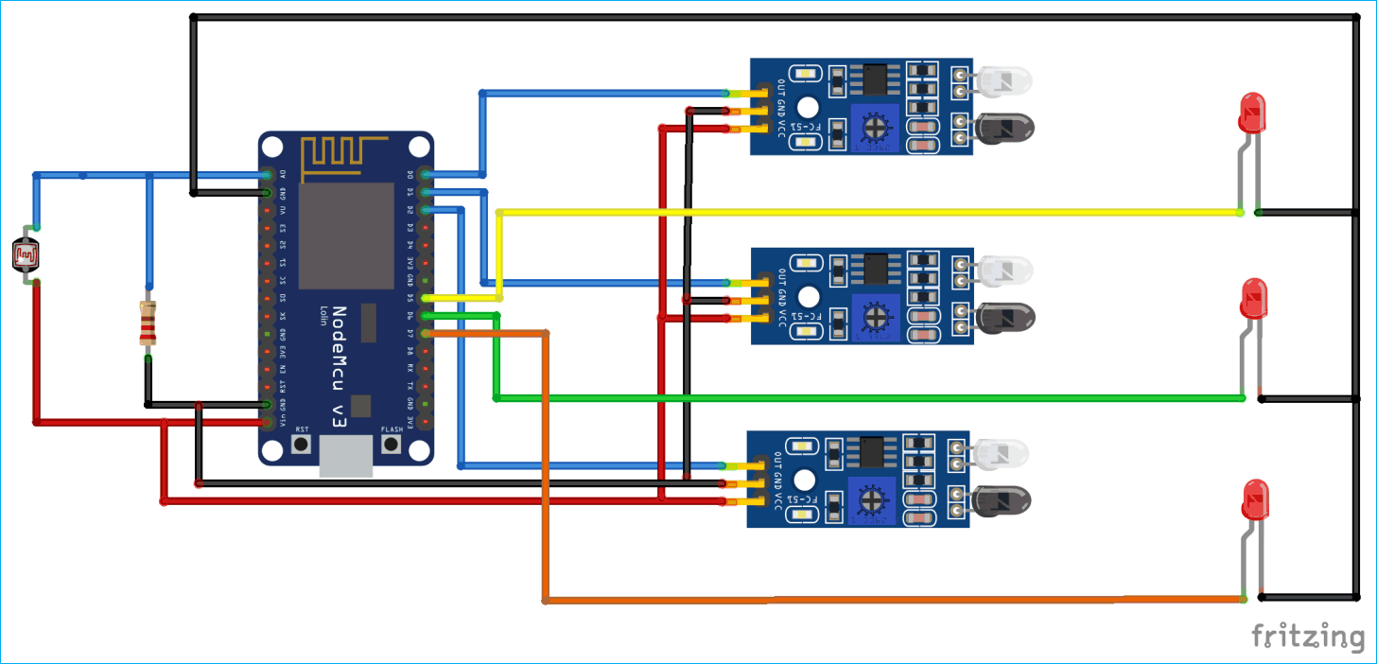
Proposed Plan

Slide 6
Project Plan/ Duration (Time line)
Sr. No. | Activity /Objective | Duration
1. | Confirming all the project plan with the team mates and if any changes needed will do accordingly | 1 Day
2. | Collecting all the materials required | 5-6 Days
3. | Start preparing the model | 2 Days
4. | Performing Dry Run | 2-3 hours
5. | After finalising everything, presenting the model | 1 hour

Slide 7
Proposed Budget
Sr. No. | Item | Quantity | Rate | Amount
2. | ESP8266 NodeMCU | 1 |  | Rs. 400
3. | Infrared sensor | 5 | Rs. 35 per piece | Rs. 175
4. | LED | 5 | Rs. 1.40 per piece | Rs. 7
5 | Battery | 1 |  | Rs. 150
6 | LDR SENSOR | 1 |  | Rs.30
 | GRAND TOTAL |  |  | Rs. 762

Slide 8


